Slide 1
Vocab Lesson 3
Roll of Thunder, Hear My Cry

Slide 2
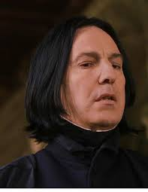
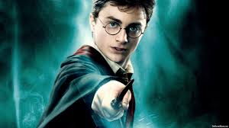
Defiant
showing resistance; bold disobedience
Example: Harry was defiant when Snape was his professor.

Slide 3
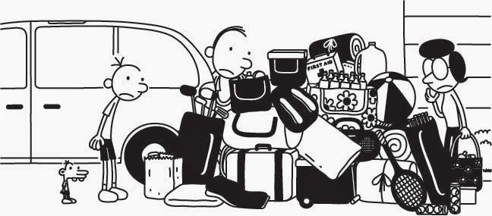
Listless
lacking energy or enthusiasm, lethargic
When his parents said they were moving, Greg did not want to help and was especially listless when he saw the giant pile of bags.

Slide 4
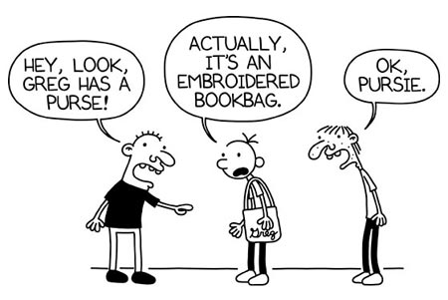
Adamant
refusing to be persuaded or to change one’s mind; insistent or uncompromising
Greg’s friends mocked his new book bag and called it a purse, even after Greg was adamant that it was NOT a purse.

Slide 5
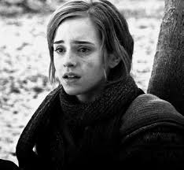
Verge
edge, border, or threshold
Hermione was on the verge of tears when she realized she got a C on her test.

Slide 6
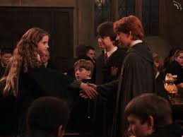
shy mouse
Harry and Hermione shook hands to seal their pact.
PACT
a formal agreement or treaty; promise

Slide 7
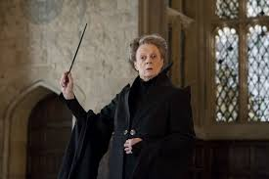
Professor McGonagall loved to expound on the secrets of magic and wizardry to the children.
EXPOUND
to present or explain in great detail

Slide 8
Snape was so haughty that Harry could not stand to be in his class.
HAUGHTY:
arrogantly superior or disdainful

Slide 9
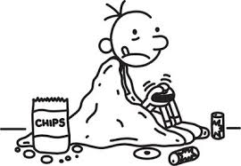
Feign
to pretend
Greg feigned having the FLU so his mom would let him stay home from school and play video games.

